Slide 1
COMP 3311 Database Management Systems
Lab 5. PL/SQL, cursors and triggers

Slide 2
Objectives of the Lab
After this lab you should be able to
Know basic PL/SQL syntax.
Write PL/SQL procedure
Build Cursors with PL/SQL.
Build triggers with PL/SQL.
2

Slide 3
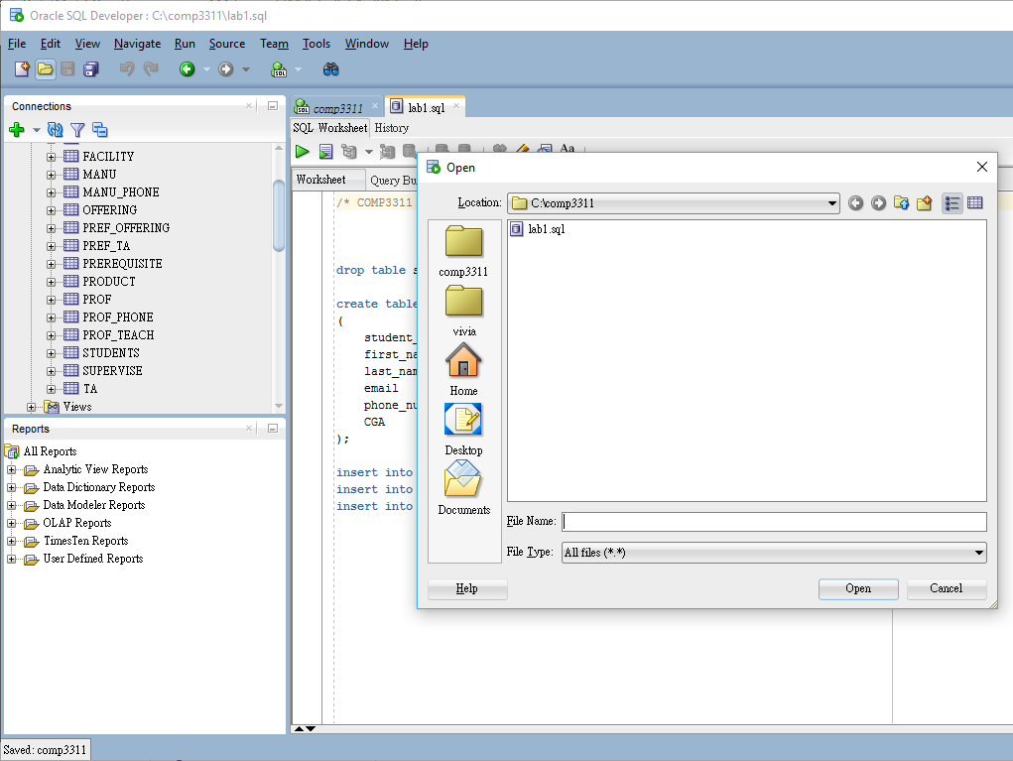
Downloading and Running SQL Script Files 1
Download lab5.sql file
Open file in SQL Developer
Check the existing tables in your account (warning: existing tables will be deleted after running lab5.sql!!!)
Read lab5.sql and run it
Refresh the database and check the original tables (all are dropped!!!)
Check also the new tables created
1
2
4
3

Slide 4
Downloading and Running SQL Script Files 2
Two effects for running the code:
1. Delete all existing tables
2. Create a set of new tables and insert the records
Read the code again to understand why 1 and 2 happen.
4

Slide 5
Introduction to PL/SQL 1
PL/SQL stands for Procedural Language/SQL.
A basic unit in PL/SQL is called a block.
PL/SQL extends the capabilities of SQL by adding many functionalities that are supported by procedural languages.
5

Slide 6
Download other PL/SQL Files
Download the following PL/SQL files (from the links here or from the course site the Lab section) to your local file system
lab5_plsql1.sql
lab5_plsql2.sql
lab5_plsql3.sql
lab5_plsql4.sql
lab5_cursor1.sql
lab5_cursor2.sql
lab5_trigger1.sql
lab5_trigger2.sql
6

Slide 7
Introduction to PL/SQL 2
A block in PL/SQL code has the following structure:
DECLARE /* Declarative section: variables, types, and local subprograms. */
BEGIN /* Executable section: procedural and SQL statements go here. */ /* This is the only section of the block that is required. */
EXCEPTION /* Exception handling section: error handling statements go here. */
END;
7

Slide 8
Introduction to PL/SQL 2
Example
DECLARE message varchar2(20):= 'Hello, World!’;
BEGIN dbms_output.put_line(message);
END;
/
In this example, the slash (/) at the end tells SQL*Plus to execute the most recently entered PL/SQL block. However, you do not need the slash if the block is executed in Oracle SQL Developer. Note that if you want to see the dbms_output.put_line, you should enable server output by running the command SET SERVEROUTPUT ON before executing your PL/SQL block.
8

Slide 9
Introduction to PL/SQL 3
PL/SQL is case insensitive
C style comments are allowed /*…*/
The SQL statements allowed in a PL/SQL program are SELECT, INSERT, UPDATE and DELETE.
Data definition language like CREATE, DROP, ALTER are not allowed.
In PL/SQL we used the “:=“ operator to assign values to a variable.
The “=“ operator (no colon) is for comparison.
9

Slide 10
Introduction to PL/SQL 4
Data types supported by SQL for defining the columns (i.e. NUMBER, INTEGER, CHAR, VARCHAR2, DATE, TIMESTAMP, etc).
Types declared to be of the same types as some database columns.
Some generic types (internal structures is not known to the database – aka to the idea of data abstraction in OO programming) are allowed.
10

Slide 11
Introduction to PL/SQL 5
Declares a variable count of the type NUMBER
DECLARE count NUMBER;
Declares a variable projectors with the same type as the no_of_projectors column in the facility table.
DECLARE projectors facility.no_of_projectors%TYPE;
Declares a variable facility_record with the same type as a row (record) of the facility table.
DECLARE facility_record facility%ROWTYPE;
11

Slide 12
PL/SQL Example 1
A simple PL/SQL that extract information from the departments table to a table called math_dept (lab5_plsql1.sql):
DECLARE
dept_name departments.name%TYPE;
dept_room departments.room_number%TYPE;
BEGIN
SELECT name, room_number INTO dept_name,dept_room FROM departments
WHERE department_id='MATH';
INSERT INTO math_dept values (dept_name,dept_room);
END;
12

Slide 13
Running PL/SQL Statements
Open file from local file system (e.g.lab5_plsql1.sql)
Check records in table MATH_DEPT
Run the script file lab5_plsql1.sql
Below statement should be written to Script Output
PL/SQL procedure successfully completed.
Check records in table MATH_DEPT again (You may run the scripts several times to see the changes)
1
4
2
3

Slide 14
PL/SQL Example 2
Flow Control: IF-THEN-ELSE-END IF (lab5_plsql2.sql)
DECLARE room departments.room_number%TYPE; BEGIN SELECT room_number INTO room FROM departments WHERE department_id='COMP'; IF (room>3000 and room<4000) THEN UPDATE departments SET room_number=room+2000 WHERE department_id='COMP'; ELSE UPDATE departments SET room_number=5528 WHERE department_id='COMP'; END IF; END;
14

Slide 15
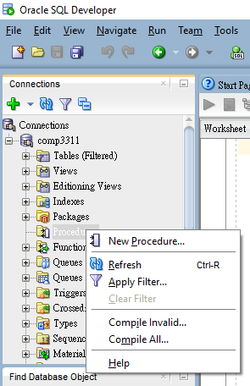
Create PL/SQL Procedure 1
Move to the right panel of SQL Developer
Right-click the Procedures object and unfold the menu
Select "New Procedure..."
Enter procedure name and parameters (if needed) using the dialog box
15

Slide 16
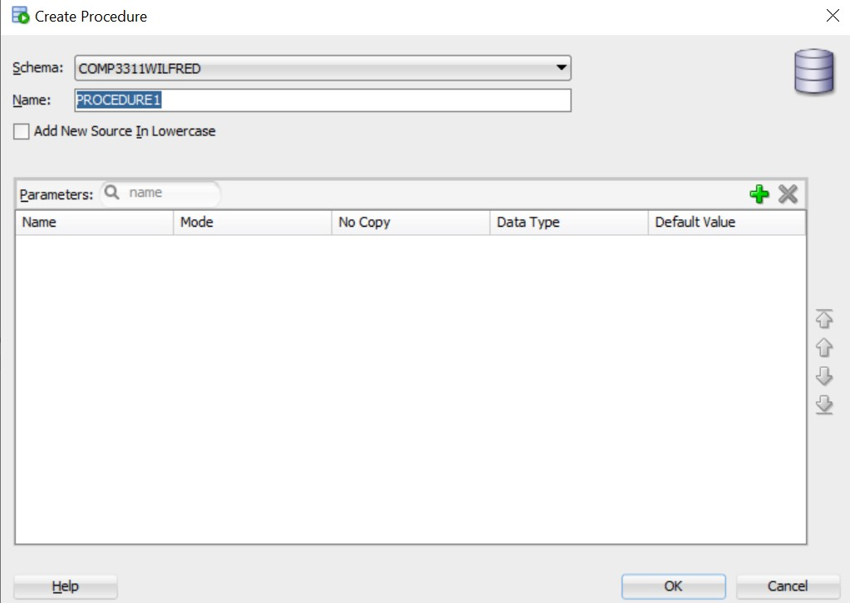
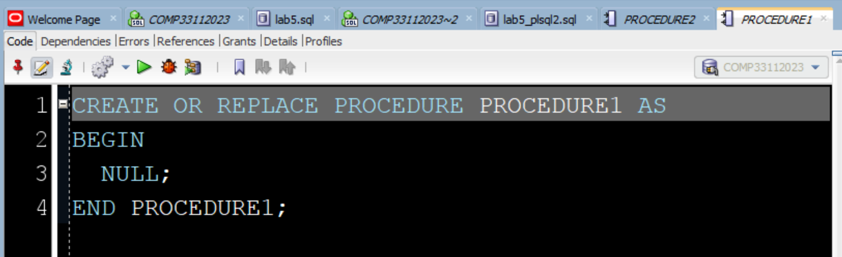
Create PL/SQL Procedure 2
After you enter the procedure name and click OK
A block appears as the worksheet on the right panel

Slide 17
Create PL/SQL Procedure 3
Turn (lab5_plsql2.sql) into a procedure by modifying the block in your procedure as follows:
create or replace PROCEDURE PROCEDURE2 AS
room departments.room_number%TYPE;
BEGIN
SELECT room_number INTO room FROM departments WHERE
department_id='COMP';
IF (room>3000 and room<4000) THEN
UPDATE departments SET room_number=room+2000
WHERE department_id='COMP';
ELSE
UPDATE departments SET room_number=5528
WHERE department_id='COMP';
END IF;
END PROCEDURE2;
17

Slide 18
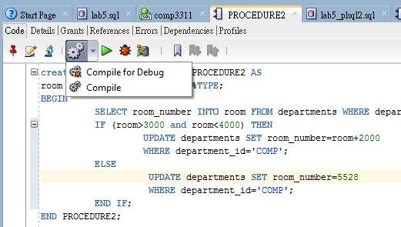
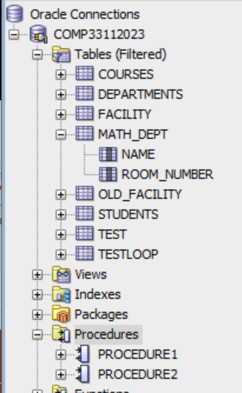
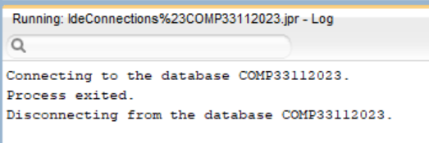
Compilation
Commit changes before run PL/SQL procedure
Open SQL worksheet
Enter “commit;”
Run statement
Click Compile
Click Run and the following message and the procedures can be found in the left panel

Slide 19
PL/SQL Example 3
Flow control: LOOP (lab5_plsql3.sql)
DECLARE i testloop.i%TYPE :=1; BEGIN LOOP INSERT INTO testloop VALUES (i); i:=i+1; EXIT WHEN i>10; END LOOP; END;
A LOOP can be terminated by the EXIT WHEN keyword
19

Slide 20
PL/SQL Example 4
Flow control: FOR LOOP (lab5_plsql4.sql)
DECLARE i NUMBER(2):=1; BEGIN FOR R IN ( SELECT * FROM facility )LOOP UPDATE facility SET no_of_computers= no_of_computers+i
WHERE department_id=R.department_id; i:=i+1; END LOOP; END;
VAR is a local variable used in the for-loop and need not be declared. In this example, R is VAR
20

Slide 21
Introduction to Cursor 1
The SELECT statement in PL/SQL can only fetch a single record but not the whole table.
If the query returns more than one records, a cursor is needed.
A cursor is like a pointer that points to only a single record each time.
Using the cursor, a sequence of records can be fetched in a one-by-one manner. This is usually done in a loop.
21

Slide 22
Introduction to Cursor 2
A cursor should be defined at the DECLARE section of the PL/SQL code.
It needs to be activated by the OPEN command.
Then we can FETCH the records one after one.
When all the records are fetched, “%NOTFOUND” will return a true.
We need to CLOSE the cursor after using it, which releases the resources.
22

Slide 23
Syntax of Cursor
DECLARE CURSOR cursor_name IS select_statement;
Example: DECLARE CURSOR facility_cursor IS SELECT * FROM facility;
The cursor facility_cursor fetches all the records from the facility table.
23

Slide 24
Status of Cursor
The following parameters are to detect the status of a cursor:
cursor_name%NOTFOUND Whether the previous fetch has failed.
cursor_name%FOUND Whether the previous fetch is successful.
cursor_name%ROWCOUNT Number of records fetched so far.
cursor_name%ISOPEN Is the cursor still open.
24

Slide 25
Example of Cursor 1
Incorporating the Cursor to PL/SQL codes (lab5_cursor1.sql) :
DECLARE
var_deptid facility.department_id%TYPE;
var_name facility.name%TYPE;
CURSOR facility_cursor
IS SELECT department_id, name FROM facility;
BEGIN
OPEN facility_cursor;
LOOP
FETCH facility_cursor INTO var_deptid,var_name;
EXIT WHEN facility_cursor%NOTFOUND;
INSERT INTO test VALUES (var_deptid,var_name);
END LOOP;
CLOSE facility_cursor;
END;
The above cursor fetches records from the facility table, and insert the values one by one into another table called test.
25

Slide 26
Example of Cursor 2
Cursor used with FOR loop (lab5_cursor2.sql) : DECLARE
var_deptid facility.department_id%TYPE;
var_name facility.name%TYPE;
CURSOR facility_cursor
IS SELECT department_id, name FROM facility;
BEGIN
FOR rec in facility_cursor
LOOP
var_deptid:=rec.department_id;
var_name:=rec.name;
INSERT INTO test VALUES (var_deptid,var_name);
END LOOP;
END;
We can use FOR loop to simplify the cursor usage in PL/SQL. The above FOR loop automatically opens the cursor, fetches rows of data from it, and closes the cursor when all rows have been fetched. In this example, the FOR loop automatically fetches attributes from facility_cursor into test, and exits the loop when all records have been fetched as the pervious example. This makes the code simpler and easier to read.
26

Slide 27
Example of Cursor 3
The facility_cursor on the previous slide is automatically opened by the FOR loop.
The rec is a rowtype data, but it is no need to declare it.
Code inside the loop is executed once for each row of the cursor, and each time department_id and name values are copied into rec.
We can access the components in rec directly using the dot notation (as shown in the code such as rec.department_id and rec.name).
FOR loop terminates automatically once all the records are fetched.
The cursor is then closed automatically.
27

Slide 28
Triggers
A trigger in a database is a stored procedure that automatically executes or fires when a specific event occurs in the database. These events can include data insertions, updates, replacements, or deletions.
Triggers are used to maintain data integrity in the database. They can adjust the entire database systematically whenever there is a change.
There are different types of triggers, such as AFTER INSERT, AFTER UPDATE. Each of these triggers is activated under different conditions. For instance, an AFTER INSERT trigger would be activated after data is inserted into a table.
28

Slide 29
Syntax for Creating Trigger
CREATE [OR REPLACE] TRIGGER trigger_name
[BEFORE | AFTER | INSTEAD OF] database_event
[REFERENCING [OLD AS old_name] [NEW AS new_name]]
trigger Level
[WHEN criteria]
BEGIN
trigger body [PL/SQL blocks]
END;
29

Slide 30
Semantics of Trigger Types
BEFORE: the trigger starts before each of the affected rows has been changed.
AFTER: the trigger starts after each of the affected rows has been changed.
INSTEAD OF: the trigger starts, instead of performing SQL on the views (virtual tables), it runs the trigger code on the original tables.
Database_event: indicates the specific database events (e.g. a user logon) that will start the trigger (e.g. tracking the logon user in an audit table).
FOR EACH ROW: the trigger starts once for each row (record).
WHEN: specifies the trigger condition.
NEW: this keyword refers to a new record retrieved
OLD: this keyword refers to an exisiting record.
30

Slide 31
Example of Trigger 1
The following trigger adds a prefix to the email address for the CS students when a new CS student record is being inserted. (lab5_trigger1.sql)
CREATE OR REPLACE TRIGGER chk_email
BEFORE INSERT ON students
FOR EACH ROW
WHEN (NEW.department_id = 'COMP')
DECLARE
prefix CHAR(3) := 'cs_';
BEGIN
:NEW.email := prefix || :NEW.email;
END;
Note that the red code is a PL/SQL block.
31

Slide 32
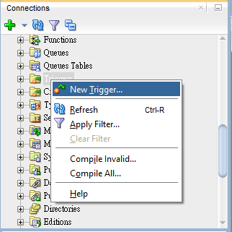
Create Trigger in SQL Developer 1
Right click on Trigger Objects in the left panel
Select “New Trigger...” in the menu
Enter the basic information for trigger chk_email (shown in previous slide)
REMARK: Statement Level or Row Level: For a trigger on a table, Statement Level fires the trigger once before or after the triggering statement that meets the optional trigger constraint defined in the WHEN condition; Row Level fires the trigger once for each row that is affected by the triggering statement and that meets the optional trigger constraint defined in the WHEN condition.

Slide 33
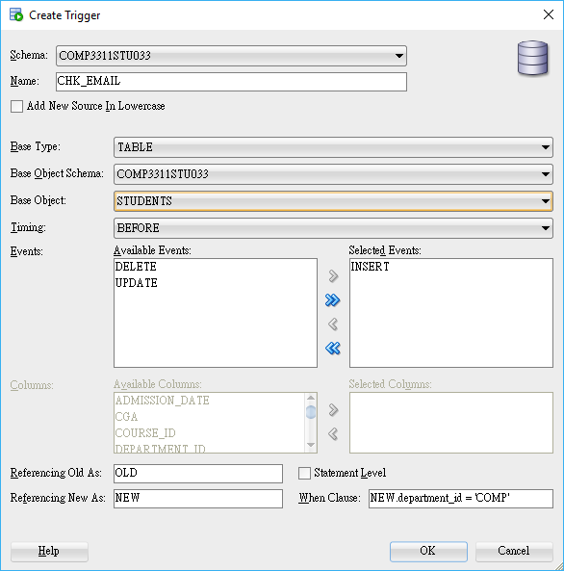
Create Trigger in SQL Developer 2
Name: CHK_EMAIL
Base Type: TABLE
Base Object:STUDENTS
Timing: BEFORE
Events: INSERT
Statement Level: false
When Clause: NEW.department_id = 'COMP'
Click “OK”
1

Slide 34
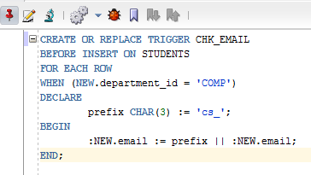
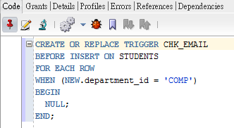
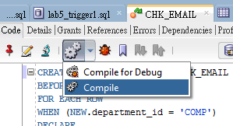
Create Trigger in SQL Developer 3
Then you will get
2
3
Type the trigger body [PL/SQL blocks]
Compile the trigger
The trigger can also be generated by run the script file trigger1.sql
4

Slide 35
Test Trigger 1
Insert new record department_id=”COMP” that into table students
open SQL worksheet
enter insert statement, for example:
insert into students values (03454321, 'Rowling', 'Joanne', 'JK', 23781234, 11.50, 'COMP','03-SEP-82', 'COMP197');
run statement
open data of table students or select * from students;
The trigger should add a prefix ”cs_” to the email address to COMP students
You can also try to insert records whose department are not COMP, for example:
insert into students values (04455333, 'Smith', 'David', 'DS', 237843221, 11.50, 'MECH','03-SEP-82', 'MECH007');
Be careful about the single quote!
35

Slide 36
Example of Trigger 2
The following example backs up the record for the facility table in the old_facility table, if the record is to be removed from the facility table. (lab5_trigger2.sql)
CREATE OR REPLACE TRIGGER backup_facility
BEFORE DELETE ON facility
FOR EACH ROW
DECLARE
id_null EXCEPTION;
BEGIN
INSERT INTO old_facility
VALUES (:old.department_id, :old.name, :old.no_of_projectors,
:old.no_of_computers);
EXCEPTION
WHEN id_null THEN
DBMS_OUTPUT.PUT_LINE('Department ID missing');
END;
36

Slide 37
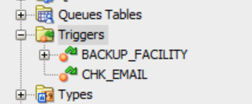
Test Trigger 2
Run script lab5_trigger2.sql
Script Output: Trigger BACKUP_FACILITY compiled
Check the Triggers object you will find the trigger
Delete record from table facility
Open SQL worksheet
Enter a delete statement, for example:
delete from facility where department_id = 'MATH';
Run the statement
Open data of table facility and old_facility
The deleted facility record is saved to table old_facility
Be careful about the single quote!
37

Slide 38
Conclusion
We covered the following topics in this lab:
Simple PL/SQL syntax.
Creating PL/SQL procedures in Oracle SQL Developer
Building Cursors with PL/SQL.
Building triggers with PL/SQL.
38

Slide 39
Appendix: PL/SQL Debugging
SQL developer allows:
Setting and/or removal of breakpoint
Monitoring and manipulation of variables
“Complie for Debug” must be executed to make an object available for debugging
Once complied for Debugging, whenever executed in “Debug” mode the code will stop where directed
39

Slide 40
Appendix: Prerequisites of Debugging
Unlock the user. Login to SQL Developer as the SYS user and execute the following commands:
alter user <username> identified by <password> account unlock;
grant debug connect session to <username>;
grant debug any procedure to <username>;
We do not have enough privilege for lab account to ruin the above commands. They are for reference if you own a database server.
40

